Slide 1
Understanding the COVID-19 Vaccine
Illinois Department of Corrections
Office of Health Services
February 2021

Slide 2
The COVID-19 vaccine is 95% effective in preventing severe or symptomatic disease which can keep you healthy and alive.

Slide 3
The vaccine will help the world develop immunity to bring an end to the disease.

Slide 4
YOU get to decide whether you want the COVID-19 vaccine to protect yourself and those around you.

Slide 5
You will not be disciplined if you say no.

Slide 6
The COVID-19 vaccines are not developed by the state or IDOC.

Slide 7
They are the same vaccines that staff and communities on the outside will be getting.

Slide 8
The Centers for Disease Control (CDC) reports increasing evidence that communities of color are experiencing higher infection rates.

Slide 9
Contributing factors include access to health care, the rate of uninsured people, occupational hazards related to essential worker status, housing conditions and racial discrimination.

Slide 10
Health experts are encouraging those in Black, LatinX and Asian-American communities to get vaccinated, as they are all classified as having a large share of high-risk individuals.

Slide 11
The Centers for Disease Control says that while the vaccine is 95% effective in helping you stay well, they still do not know if it will prevent you or others from passing the virus along to another person.

Slide 12
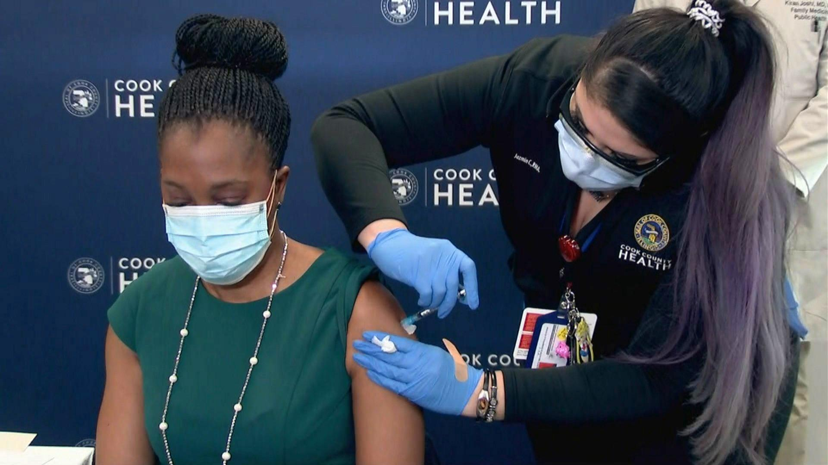
Illinois Department of Public Health Director Dr. Ngozi Ezike receives her first dose of the COVID-19 vaccine on January 12, 2021.

Slide 13
FREQUENTLY ASKED QUESTIONS

Slide 14
Is the COVID-19 vaccination safe?
YES!

Slide 15
In the United States, the vaccines being used now have gone through large clinical trials.

Slide 16
In addition, the CDC is monitoring the safety of vaccines that have been given to Americans over the past weeks.

Slide 17
Should I worry about side effects?
Millions of people have been vaccinated already and serious side effects are rare.

Slide 18
There can be pain in the upper arm, fatigue, headache, and in a small number of cases, fever or chills.

Slide 19
Side effects are generally resolved within 48 hours.

Slide 20
These side effects are a sign of an immune system kicking into gear. They do not signal that the vaccine is unsafe.

Slide 21
When can I get vaccinated?
There is not yet enough vaccine to go around. Illinois has set priorities as to who needs the vaccine the most.

Slide 22
In the first phase, medical staff are at the top of the list.

Slide 23
Later in the first phase, corrections staff and incarcerated people have been identified as a priority.

Slide 24
People who value your health and safety fought for incarcerated people to be included in Phase 1 because it is important.

Slide 25
Illinois is prioritizing prisoners among direct care providers, schoolteachers and correctional staff!

Slide 26
Most people in the state will not get the vaccine until everyone in the first phase, including you, have been given the chance to get it.

Slide 27
That is because people who live in shared spaces like nursing homes, prisons, and veterans' centers are at higher risk.

Slide 28
IDOC anticipates vaccinations will begin in correctional facilities in February.

Slide 29
We will first be conducting a survey to determine how many of you are interested in taking it.

Slide 30
Vaccinations will be administered by either medical technicians with the Illinois National Guard or healthcare workers from the Illinois Department of Public Health.

Slide 31
You will be notified when a vaccination schedule has been determined for your facility.

Slide 32
How much will I have to pay for the vaccine?
The vaccine will be provided at no cost.

Slide 33
How long will it take for me to be protected?
It will take 10 to 14 days for your body to build immunity after the first dose. The second dose increases your immunity further.

Slide 34
Was the development of this vaccine rushed?
No. Even though the vaccine was developed quickly, governments around the world allocated funding to support vaccine research and collaboration among experts in the medical community.

Slide 35
The vaccine was still subjected to the same testing that all vaccines must complete to make sure they are safe and effective.

Slide 36
Do I need to wear a mask after being vaccinated?
You will still need to wear your mask and social distance for the foreseeable future.

Slide 37
Does the new vaccine contain any COVID-19 virus?
The COVID-19 vaccination does NOT have any virus present.

Slide 38
How long will my immunity last after the vaccination?
Studies are underway to determine how long immunity lasts.

Slide 39
Are there new strains of the COVID-19 virus?
There is a new strain that is more infectious, and cases have been confined in Illinois as of January 15.

Slide 40
Health officials say that the strain does not make people sicker, but it does increase risk of death.

Slide 41
Officials also say the vaccine should protect people from this new strain, but more study is underway.

Slide 42
Will the COVID-19 vaccine cause me to test positive for COVID-19?
COVID-19 vaccines will not cause a positive test result.

Slide 43
Should I get vaccinated if I have already had COVID-19?
People who have gotten sick with COVID-19 may still benefit from getting vaccinated.

Slide 44
You can be vaccinated as soon as 14 days after testing positive for COVID-19.

Slide 45
I have severe medication or food allergies. May I take this vaccination?
People with severe allergies should talk with a physician first.

Slide 46
Reach out to healthcare staff to discuss your health care needs.

Slide 47
Will the COVID-19 vaccine change my DNA?
No. According to the National Society of Genetic Counselors, the genetic material in the vaccines is called mRNA, and it is different from DNA.

Slide 48
Rumors on the Internet about the vaccine changing DNA have been proven false by trusted sources.

Slide 49
Will this vaccination work for all ages, races and ethnicities?
The vaccine is equally effective across different ethnic and racial groups.

Slide 50
Its effectiveness is slightly lower in people 65 and older.

Slide 51
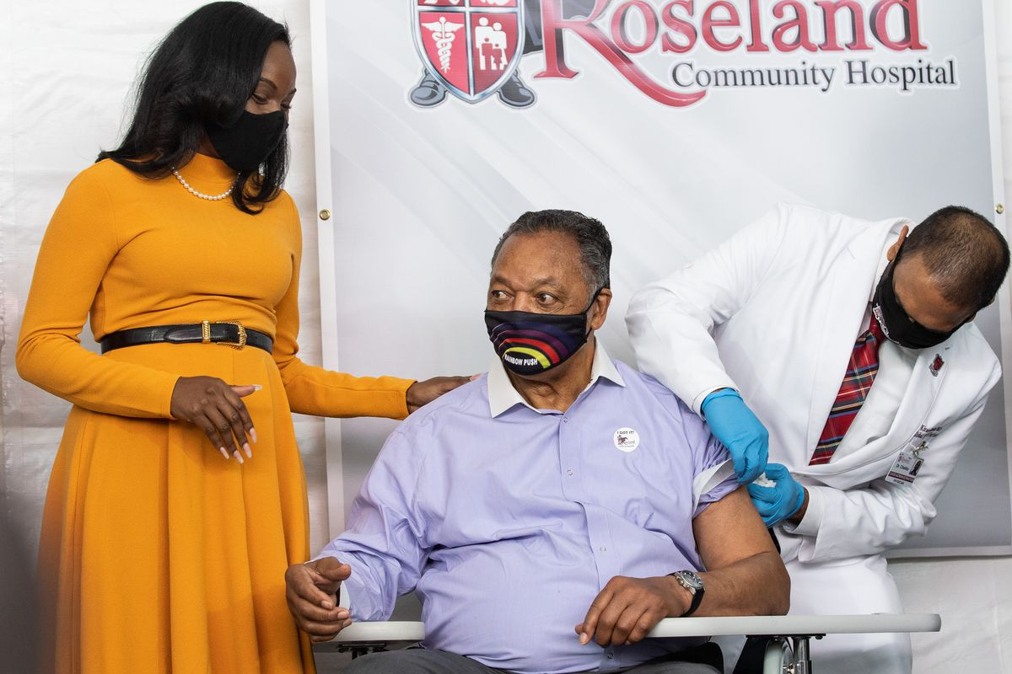
Dr. Kizzmekia “Kizzy” Corbett, the Black woman who co-led the National Institutes of Health team that discovered Moderna’s coronavirus vaccine, lends a supportive hand as the Rev. Jesse Jackson receives the vaccine.

Slide 52
If you have additional questions about the COVID-19 vaccine, please reach out to healthcare staff at your facility.

