Slide 1
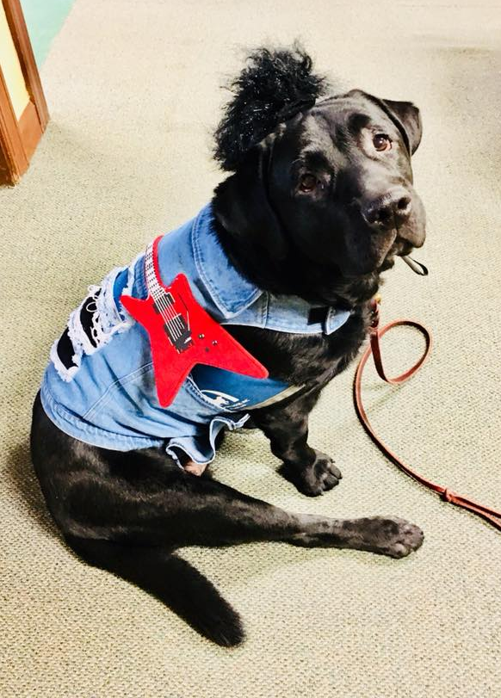
Illinois Standards for Sex Offender Treatment and Evaluation
Jacob Harlow
McLean County Assistant State’s Attorney
Office: 309-888-5406
Cell: 573-301-3591
Email: jacob.harlow@mcleancountyil.gov

Slide 2
Illinois Sex Offender Case Studies
People v. Morger
People v. Minnis
State v. Pepitone

Slide 3
Illinois Sex Offender Case Studies
People v. Morger
People v. Minnis
State v. Pepitone

Slide 4
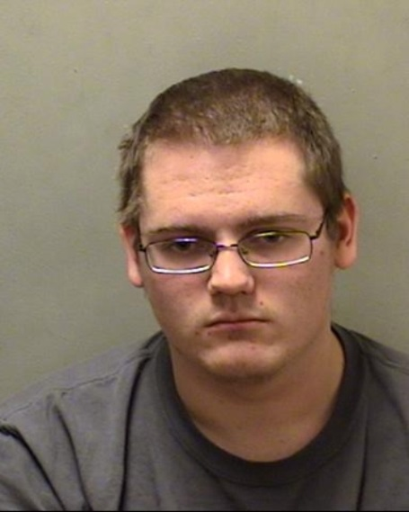
People v. Conrad Morger
59 N.E.3d 219, 405 Ill.Dec. 926 (4th Dist. 2016)
Charged with criminal sexual abuse and aggravated criminal sexual abuse.
Found guilty of both counts after a bench trial.
Sentenced to 48 months sex offender probation.

Slide 5
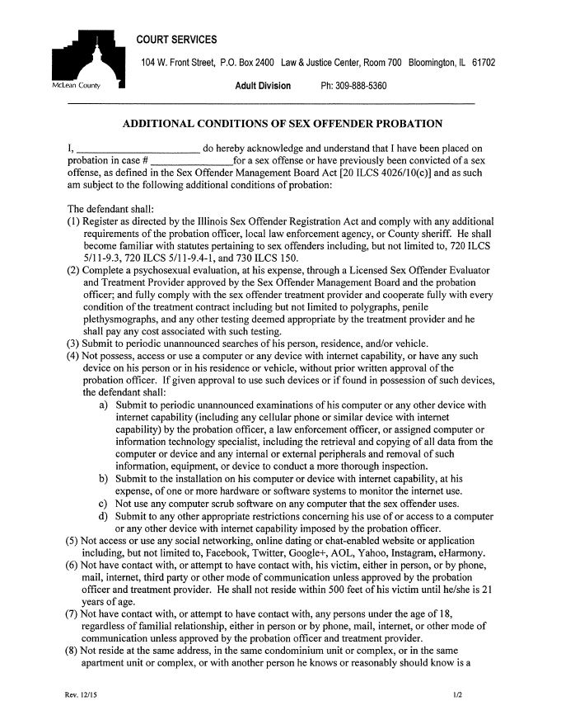
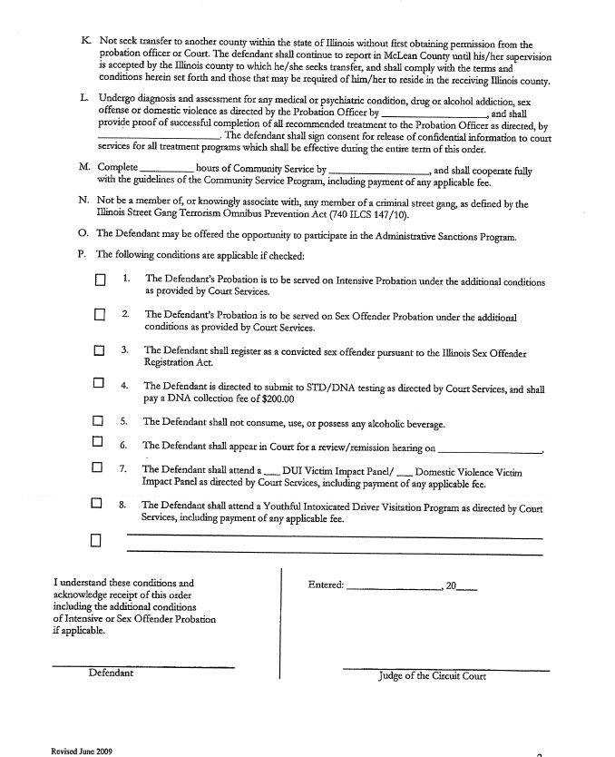
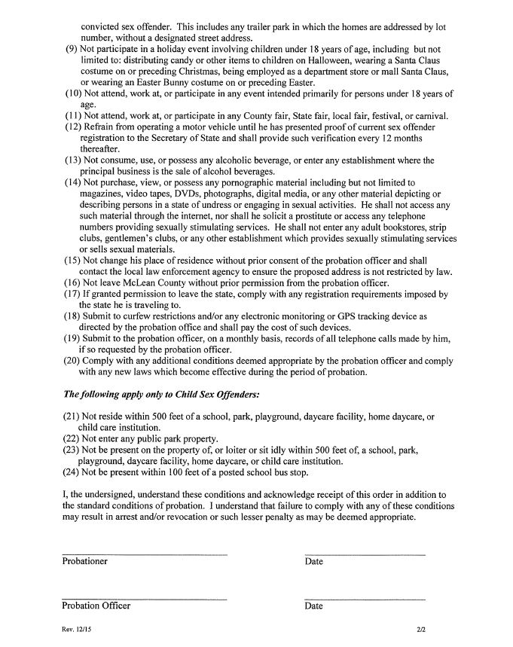

Slide 6
People v. Conrad Morger
59 N.E.3d 219, 405 Ill.Dec. 926 (4th Dist. 2016)
“Because the imposition of probationary conditions is part of sentencing, the trial court must impose any such conditions at the sentencing hearing and may not delegate that authority to any third party, including the court services department. The court could easily have done so in this case by (1) signing, at the sentencing hearing, the sex offender probation order that contained the probationary conditions; (2) informing defendant that the court was imposing these special probationary conditions; (3) explaining these special conditions to defendant, including why the court was imposing them; and (4) giving a copy of that order to defendant.”
“We conclude that the trial court erred when it purportedly imposed 24 probationary conditions merely by checking a box on the probation order, which stated that ‘defendant's probation [was] to be served on Sex Offender Probation under the additional conditions as provided by Court Services.’ Defendant acknowledged receipt of those additional probationary conditions only after the court services department provided him a copy of the two-page form that contained these additional conditions four days after the sentencing hearing.”
Charged with criminal sexual abuse and aggravated criminal sexual abuse.
Any additional [probationary] condition not expressly authorized by statute may be imposed as long as it is (1) reasonable and (2) relates to (a) the nature of the offense or (b) the rehabilitation of the defendant as determined by the trial court.
Found guilty of both counts after a bench trial.
Sentenced to 48 months sex offender probation.

Slide 7
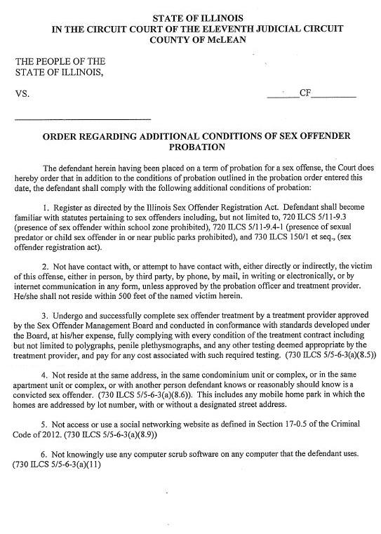
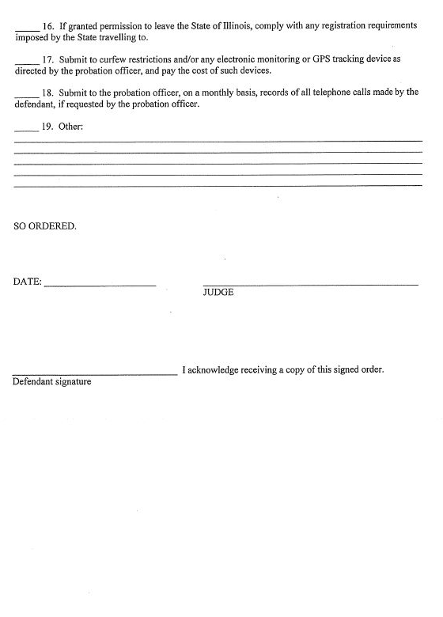
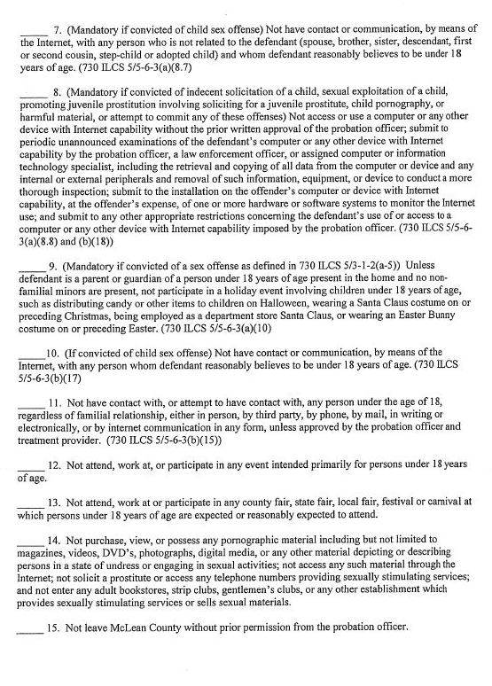

Slide 8
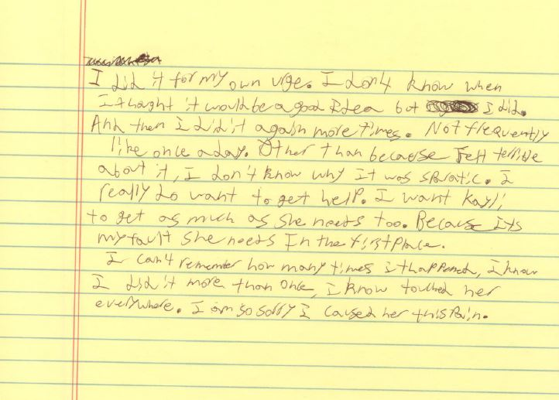

Slide 9
Illinois Sex Offender Case Studies
People v. Morger
People v. Minnis
State v. Pepitone

Slide 10
Illinois Sex Offender Case Studies
People v. Morger
People v. Minnis
State v. Pepitone

Slide 11
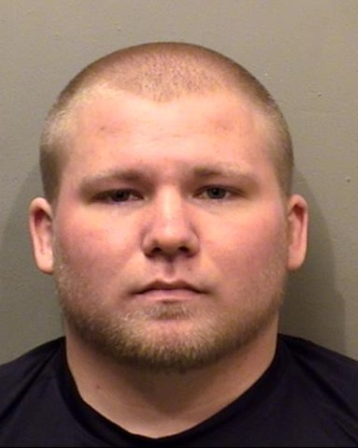
People v. Mark Minnis
67 N.E.3d 272, 409 Ill.Dec. 60 (2016)
The Internet disclosure provision advances the substantial governmental interest of preventing sex offenses against children and protecting the public from the danger of recidivist sex offenders.
To survive intermediate scrutiny, a content-neutral regulation of protected speech (1) must serve or advance a substantial governmental interest unrelated to the suppression of free speech and (2) must not burden substantially more speech than necessary to further that interest—or in other words, it must be narrowly tailored to serve that interest without unnecessarily interfering with first amendment freedoms.
Charged with violating Sex Offender Registration Act for failing to register his Facebook account.
First Amendment freedom of speech protects/applies to anonymous Internet communications.
Trial court ruled that the Internet disclosure provision of the Sex Offender Registration Act (requirement to disclose identities and websites) was overbroad in violation of First Amendment.
Disclosure law requires lesser (intermediate scrutiny) because it affects content neutral speech.
The Internet disclosure provision is tailored to avoid chilling more speech than necessary, or in other words, to lessen the number of unconstitutional applications.

Slide 12
Illinois Sex Offender Case Studies
People v. Morger
People v. Minnis
State v. Pepitone

Slide 13
Illinois Sex Offender Case Studies
People v. Morger
People v. Minnis
State v. Pepitone

Slide 14
State v. Marc Pepitone
75 N.E.3d 297, 412 Ill.Dec. 317 (3rd Dist. 2017)
Convicted of being a child sex offender in a public park.
Appellate court ruled that this law violates substantive due process clause of the Constitution.
Law is not reasonably related to its goal of protecting the public, especially children, from a child sex offender, nor is it drafted in such a way as to effect that goal without sweeping too broadly by criminalizing a wide array of innocent conduct.

Slide 15
Illinois Sex Offender Case Studies
People v. Morger
People v. Minnis
State v. Pepitone

